Slide 1
Armor Detection
Ethan, Chuwei, Dayana

Slide 2
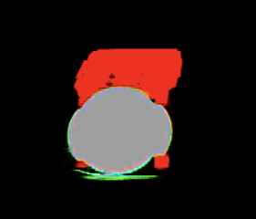
Task Description
Detect armor using OpenCV to identify other robots
Modify image contrast, exposure, colors, etc.
Detect lights
Color, luminosity, velocity, shape, size
Specifically need to find ways to distinguish lights from each other
Deal with disruption of image (flying pellets, camera issues, and etc)
Detect numbers to ID robots
Tesseract Text Recognition
Train using data from first person view. Preferably, data from in combat
Example of CV view of armor

Slide 3
Resources
Light Detector from Purdue RM Team:
https://github.com/RoboMaster-Club/spring-2020-vip-course/blob/master/Software/LightDetector.h
The code would essentially get an image from the “dart’s” camera and uses openCV to find the position of the light and either return true/false if light found
Tracking distance from TAMU RM Team:
https://github.com/TAMU-RoboMaster-Computer-Vision/cv_main/blob/master/source/tracking/tracking_main.py
Determines distance between two objects where one could be itself or just two different objects

Slide 4
Resources
Tracking target from UW Advance Robotics:
https://github.com/uw-advanced-robotics/aruw-vision-platform-2019/blob/master/aruw_vision/src/target_tracker.py
It essentially tracks individual target plates to help identify the target to shoot at
Armor Detection from RoboRTS Team:
https://github.com/RoboMaster/RoboRTS/tree/ros/roborts_detection/armor_detection
The package includes different algorithms for armor detection

Slide 5
Plans
In person testing of how the shooting mechanism
Distance calculation algorithm based on TAMU’s existing github repo
Bullet drop compensation
Purdue / UW / RoboRTS resource overview
Each member study one repo, weekly meeting to share learning
Determine the best way to track armor modules (light / number)
(Low priority) Study the barrel overheating mechanism
Be familiar with rules related to shooting
Figure out how CV module will be integrated into the robot

